Slide 1

Acceleration Signals in Determining Gait-Related Difficulties and the Motor Skill of Walking in Older Adults
Pritika Dasgupta, MPH MHI MS
Funded by the
National Library of Medicine under the
training grant 4T15LM007059-30.
Advisor: Ervin Sejdić, Ph.D.

Slide 2
IMPACT OF GAIT DIFFICULTIES IN OLDER ADULTS
Exorbitant healthcare costs
Scientific need to quantify the loss of motor skill of walking through gait measures
Simple gait measures are not adequate
Literature is overpopulated with multiple acceleration gait measures (AGMs) from wearable devices
Lack of gold standard
Minimal consensus on the validity of using many of these AGMs
Notes:
HH: Quick summary points
To help reduce these costs, we want to predict what might lead to a fall
And reduce the risk
Characterizing gait to reduce falls
Combine with slide 3
There are a lot of complexity and variance that make this issue non-trivial
Limited motor skill of walking or a mobility disability can lead to exorbitant healthcare costs
Scientific need to quantify the loss of motor skill of walking through gait measures

Slide 3
Smoothness◁
Efficiency ◁
Automaticity ◁
Adaptability ◁
▷Variability
▷ Stability
▷ Symmetry
THE MOTOR SKILL OF WALKING
3
Gait Cycle Event ◁ Timings◁
Statistical Features ◁
Signal Frequency ◁ Features ◁
▷Time-Frequency
▷ Features
▷ Information-
▷ Theoretic Features
ACCELERATION
GAIT
MEASURES
Notes:
Singular concept
Many aspects, often interrelated
Set of learned coordinated actions that result in the translation of the body through space while maintaining postural control and balance

Slide 4
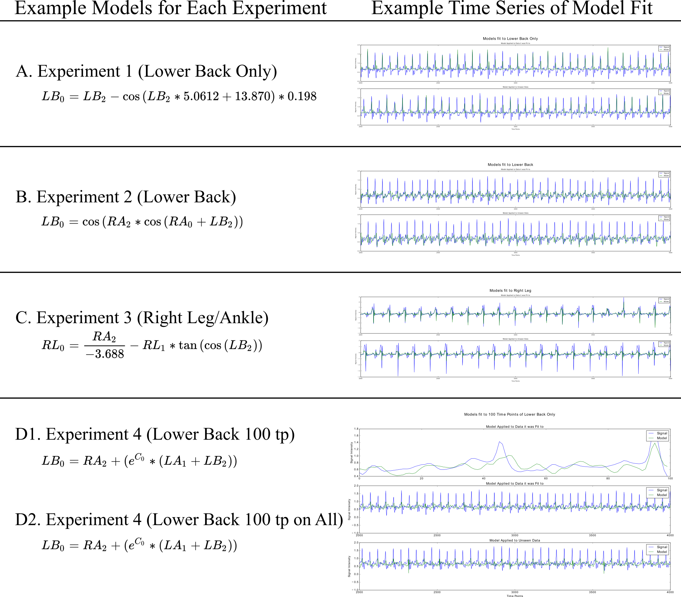
Use Of Machine Learning On Acceleration Gait Measures In An Acute Environment vs. Lab Setting
Creation of Symbolic Regression Models (Lab Setting)
Classifying history of falls and 90-day fall follow-up in older adults (Acute Setting)
Features were derived from signal frequency measures and statistical features
Excellent results with SVM and NN (respectively, as shown below) - for classifying future falls
Future work to be done with CNN-RNN hybrids – for classifying past falls
Sensitivity | Specificity | PPV | NPV | Accuracy
1 | 0.99 | 0.93 | 1 | 0.99
1 | 0.975 | 0.82 | 1 | 0.978

Slide 5
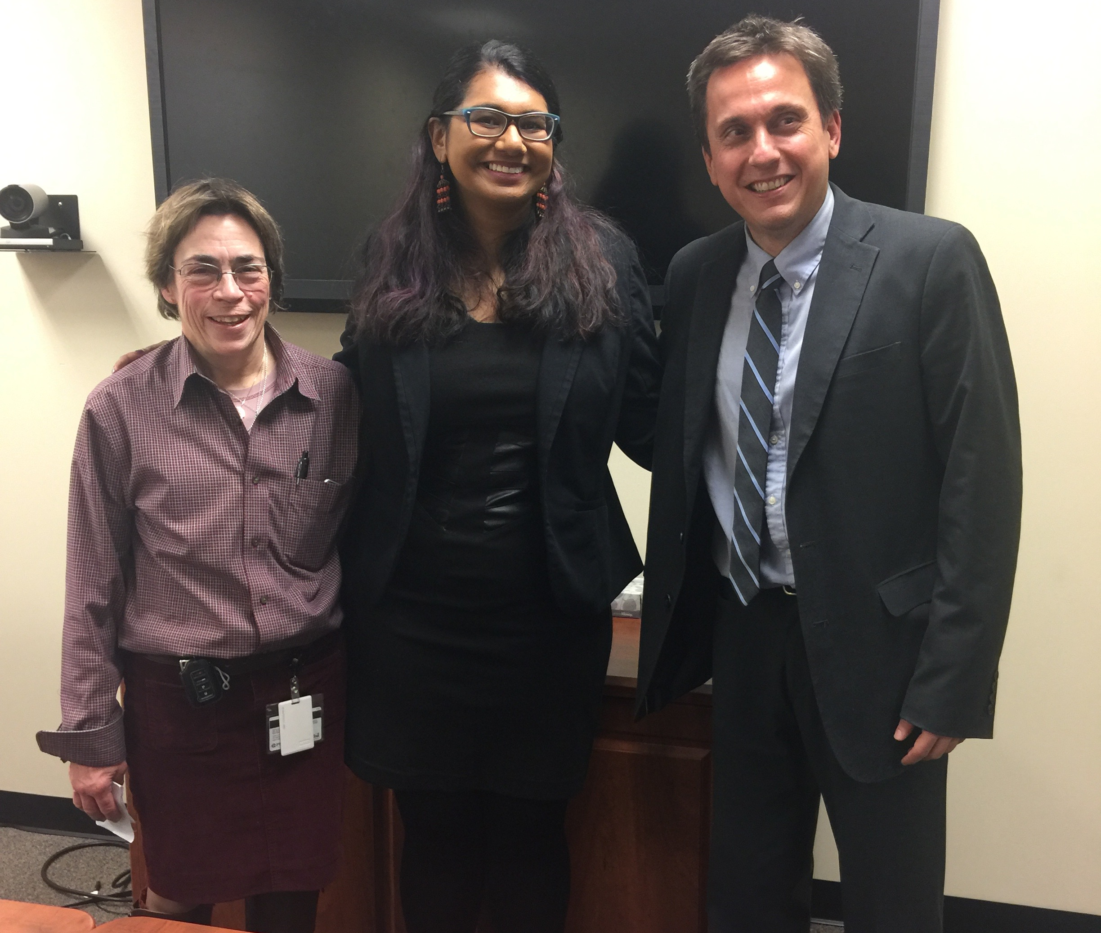
THANKS!
National Library of Medicine under the training grant 4T15LM007059-30
Doctoral Committee
DBMI Training Program
Family and Friends
Any questions?

